Slide 1

EMPLOYEE MANAGEMENT SYSTEM
COURSE: DATABASE SYSTEMS
PROJECT: SUPERMARKET GROUP: GROUP 4
NAME: KYAZZE RODRICK KATIMBO
REG NO: 2025/BCS/109/PS

Slide 2

INTRODUCTION
The Employee Management System is a database-based system designed to help supermarkets manage employee information efficiently.
It replaces manual record-keeping methods with a computerized system for better storage, retrieval, and management of employee data.

Slide 3
WHY THIS SYSTEM?
The supermarket manages employee records manually, causing delays, errors, poor attendance tracking, payroll mistakes, and difficulty monitoring staff performance.
Therefore the developed Employee Management System stores employee details, manages attendance, tracks salaries, assigns roles, and generates reports.

Slide 4

SYSTEM REQUIREMENTS
Computer system
Database software (e.g. MySQL)
Programming tools (e.g. Visual Studio Code or NetBeans)
Internet connection

Slide 5

OBJECTIVES OF THE SYSTEM
To store employee records digitally.
To track attendance of employees.
To manage employee roles and salaries.
To assign work shifts.
To improve efficiency in employee management.
To reduce paperwork and save time.

Slide 6

SYSTEM SCOPE
Employee registration
Attendance management
Role assignment
Shift scheduling
Salary and payroll management

Slide 7
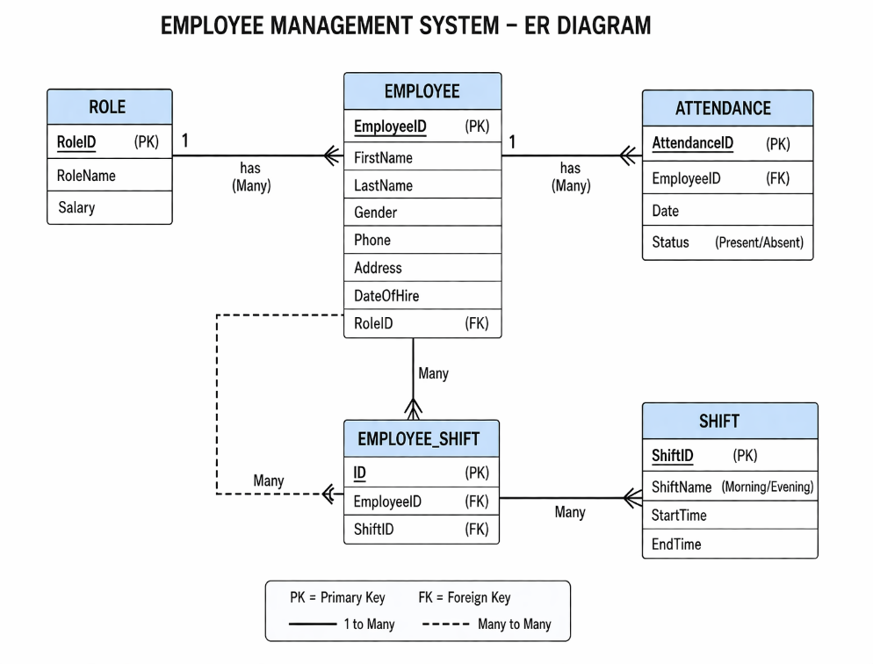
SYSTEM ER DIAGRAM

Slide 8
SYSTEM TABLES AND THEIR ATTRIBUTES
Employee Table | Role Table | Attendance Table | Shift Table | EmployeeShift Table
EmployeeID(PK) | RoleID(PK) | AttendanceID(PK) | ShiftID(PK) | ID(PK)
FirstName | RoleName | EmployeeID(FK) | ShiftName | EmployeeID(FK)
LastName | Salary | Date | StartTime | ShiftID(FK)
Gender |  | Status | EndTime
Phone
Address
DateOfHire
RoleID(FK)

Slide 9
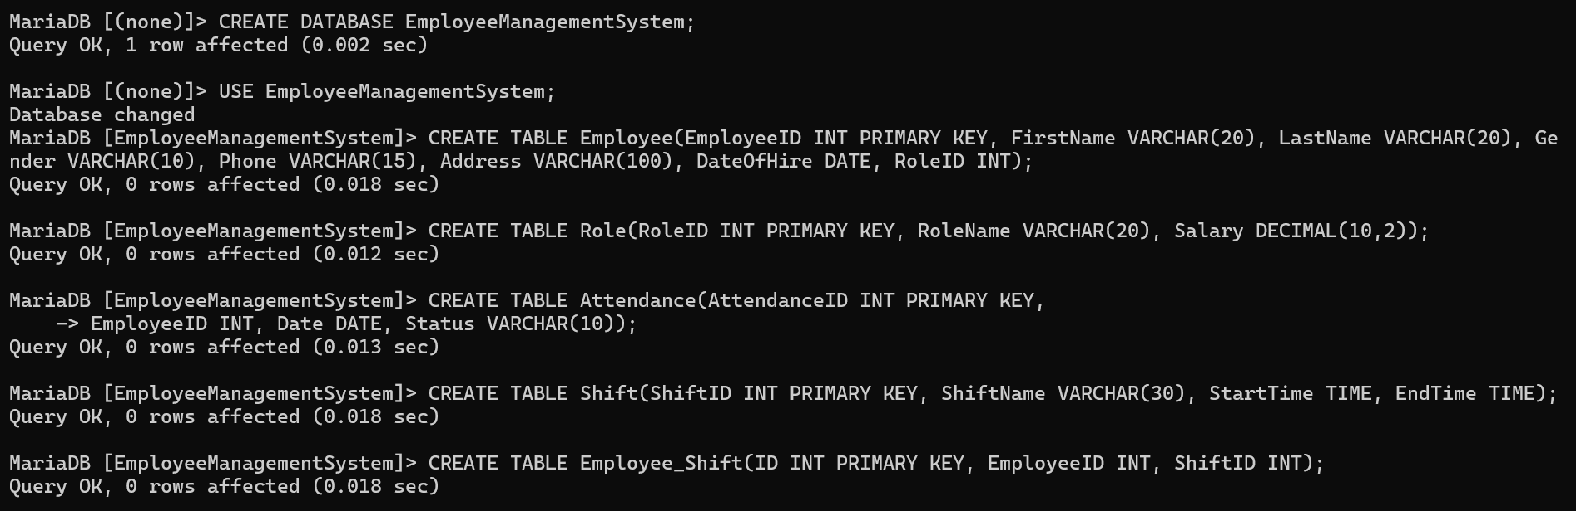
TABLES QUERIES

Slide 10
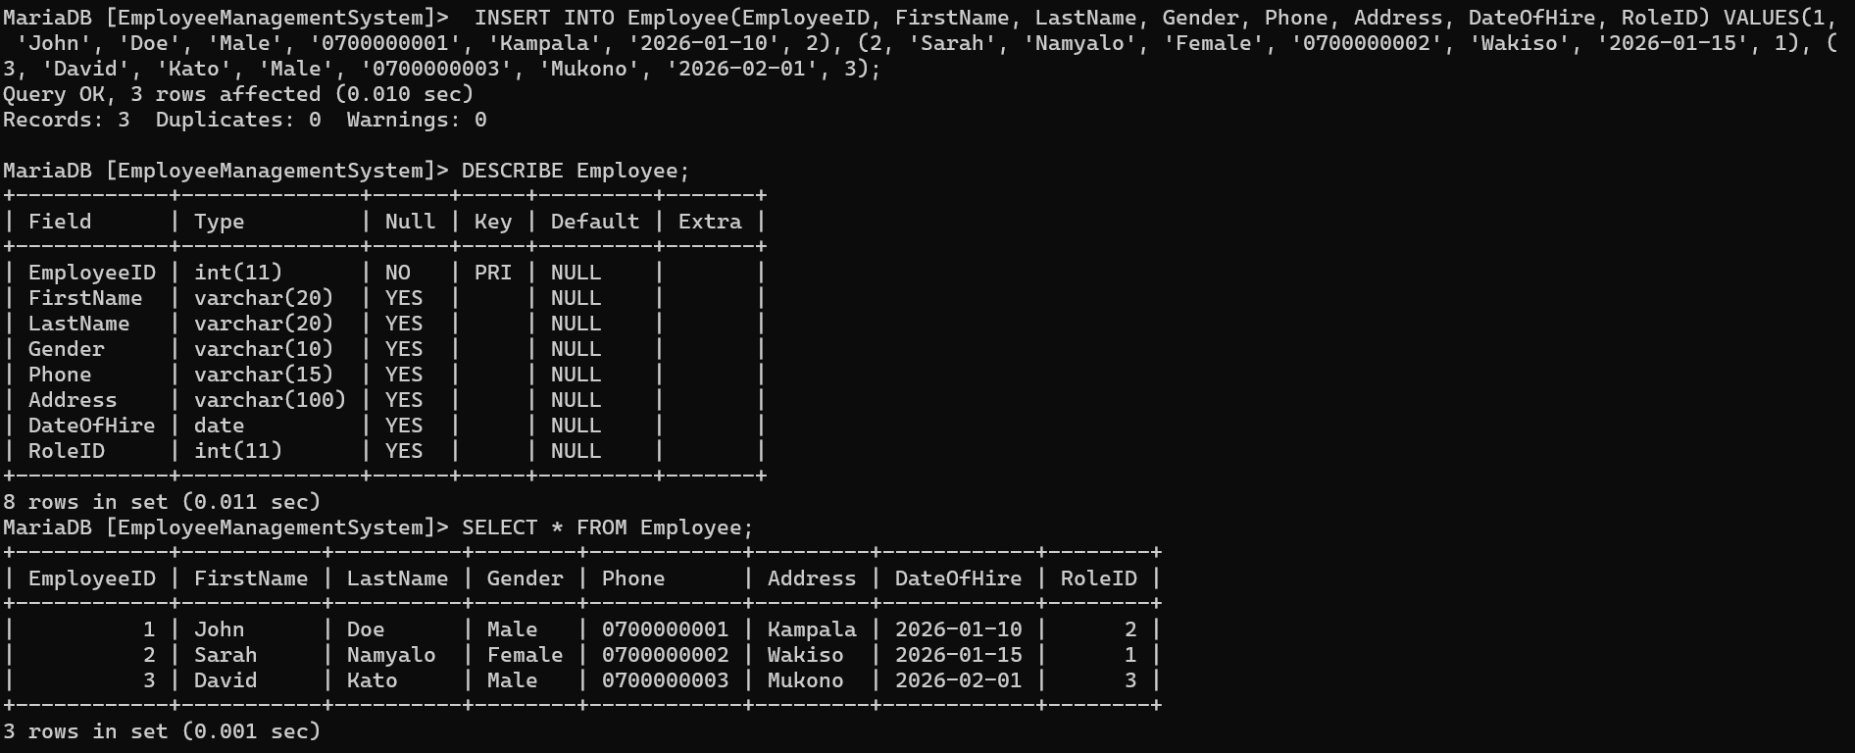
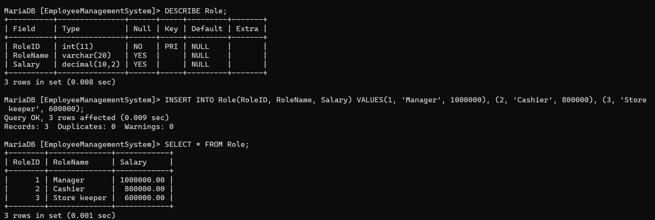
SOME OF THE TABLES RESULTS

Slide 11
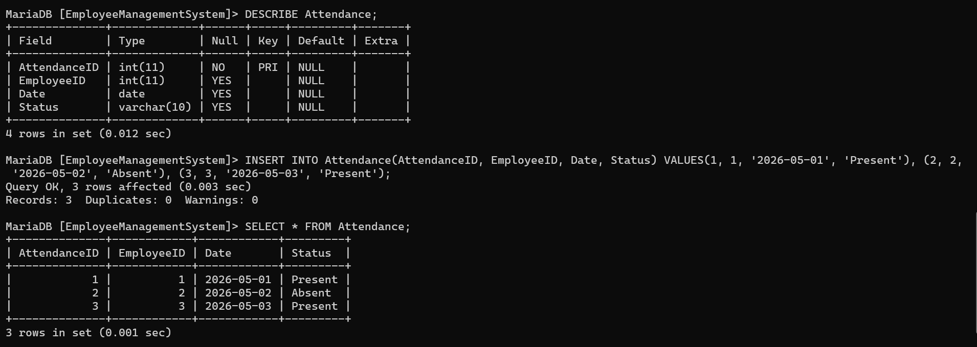
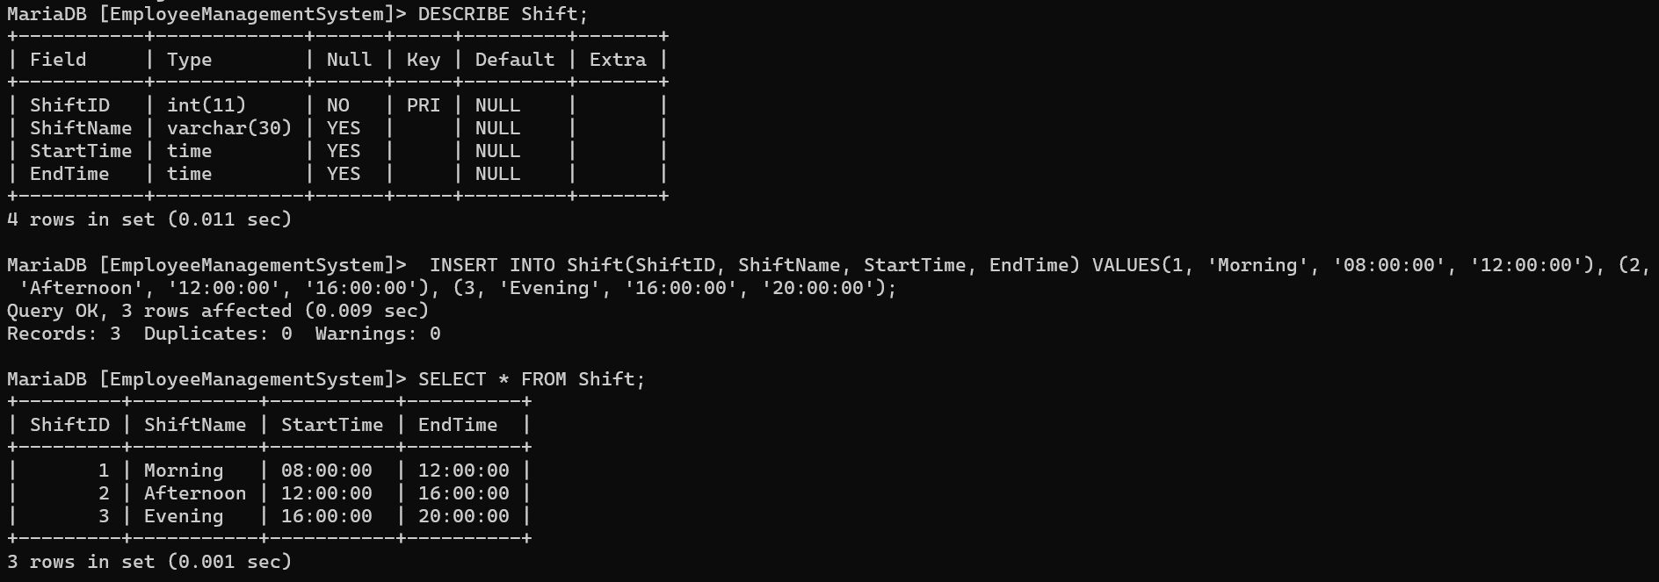
SOME OF THE TABLES RESULTS

Slide 12

SYSTEM BENEFITS
Faster employee record management.
Reduced paper work costs.
Accurate salary calculation.
Improved attendance tracking
Better decision making by management.
Increased employee accountability.
Improved data organization.
Enhanced data security.
Time saving.
Improved data accuracy and validity.

Slide 13

SYSTEM LIMITATIONS
▪Requires computers and electricity.
▪Requires user training.
▪Needs maintenance.
▪Maynot work well without internet which is costly.

Slide 14
SYSTEM RISK ASSESSMENT
System failure or bugs
Data loss if not backed up
Employees resisting the system
Poor system usage
Security threats

Slide 15

Thank you for your attention!!!

